Slide 1
The National Resident Matching Program
INFO 4220 – Networks II: Market Design
Adapted from Haeringer Ch.10

Slide 2
Today and next lecture
We will examine the case of the National Medical Residence Program:
Description and history
Equivalence (of the original) NRMP to the deferred acceptance algorithm
Problems with the original NRMP and experimentation to improve algorithm
The rural hospital theorem

Slide 3

Probably the longest running and most successful use of matching theory for a real-life problem
After completing medical school, students must spend a few years working in hospitals as residents
Today, the US NRMP Involves 30,000+ candidates, and 3,800 residency programs

Slide 4
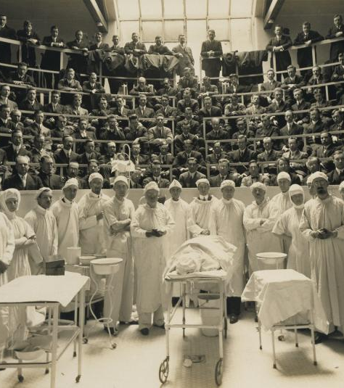
Residence Matching in the 1900s
Gilbert's Studio, Medical School Class and Staff (with Cadaver), ca. 1900, gelatin silver print, Smithsonian American Art Museum

Slide 5
Residence matching 1900-1945
Matching was decentralized:
  Candidates had to apply separately for positions
  Hospitals decided who to hire
Competition between hospitals to get best candidates lead to unravelling:
  Candidates hired several years before graduation
What’s the problem with unravelling?
  Those who already secured a job have less incentives to study and perform
  Likely that students and hospitals that matched early did not get the best match they could

Slide 6
Residence Matching 1945-1952
In 1945 medical schools agreed not to disclose information about students before a certain date
  Idea was to avoid early competition
This didn’t solve anything. Matching mechanism is the same, just changed how much time people had to match. It created a bottleneck
Matching is slow:
  Contacting candidates and making offers take time
  Candidates can take their time to respond (specially if they are hoping for a better offer)

Slide 7
Residence Matching 1945-1952
Between 1945 and 1950 the time given to candidates to respond decreased:
  10 days in 1945
  12 hours in 1950
It didn’t help improving the market
Mismatches still were happening:
  Pessimistic students would accept a bad offer (it is risky to say no if you don’t think you will get a better offer)
  Optimistic students would end up with a bad match or unmatched (they refuse a good offer because they are hoping for a better offer that never arrives)

Slide 8
National Resident Matching Program
The first job of medical students after they graduate is called the “residence” and is a continuation of their education
When the market is not centralized, the hospital-doctor matching problem unravels
Around 1945 medical associations tried multiple fix to the unravelling problem without success
In 1952 they introduced a centralized clearinghouse that solved the issue and still operates today

Slide 9

The National Resident Matching Program
In 1952, several American medical associations agreed to create a centralized matching mechanism
Students and hospitals submit (simultaneously) a ranked order preference list
An algorithm finds the matches
Matching is announced on what is come to be known as “Match Day”
Image from: https://uofuhealth.utah.edu/notes/postings/2017/03/match-day-2017.php

Slide 10

Medical Match Process
Students submit application to hospitals
Hospitals invite the students they like for interviews
After the interviews happen:
  Hospitals submit their preferences over the doctors they interviewed to a centralized clearinghouse
  Students submit their preferences over hospitals with which they interviewed to the same clearinghouse
  An algorithm matches hospitals and students
There are rules: Hospitals cannot ask student what other hospitals they have interviewed with, and hospitals-doctors cannot communicate after the interviews

Slide 11


Slide 12
The NRMP Algorithm
Alvin Roth studied the NRMP algorithm (being used at the time) in 1984
He demonstrated that algorithm was equivalent to the Deferred Acceptance Algorithm (with hospitals proposing)
Main difference with what we did last class is that now we are talking about a many-to-one matching
  Residents choose one hospitals
  Hospitals takes many residents

Slide 13
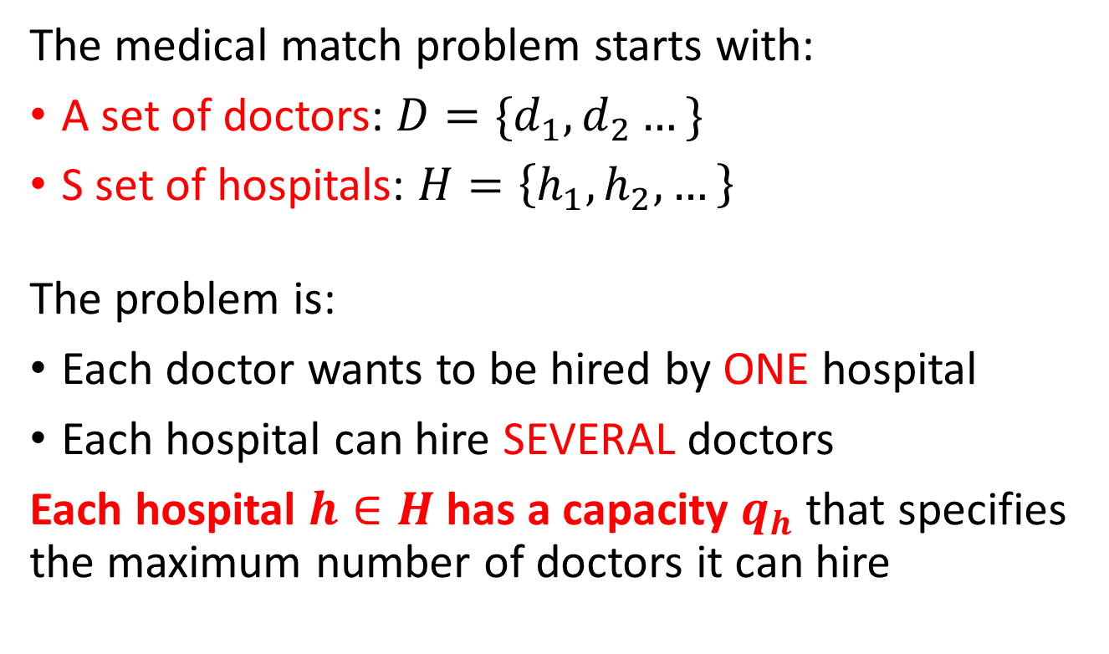
Many-to-one matching model
The medical match problem starts with:
A set of doctors: $D=\{d_{1},d_{2}…\}$
S set of hospitals: $H=\left\{h_{1},h_{2},…\right\}$
The problem is:
Each doctor wants to be hired by ONE hospital
Each hospital can hire SEVERAL doctors
Each hospital $h∈H$ has a capacity $q_{h}$ that specifies the maximum number of doctors it can hire

Slide 14
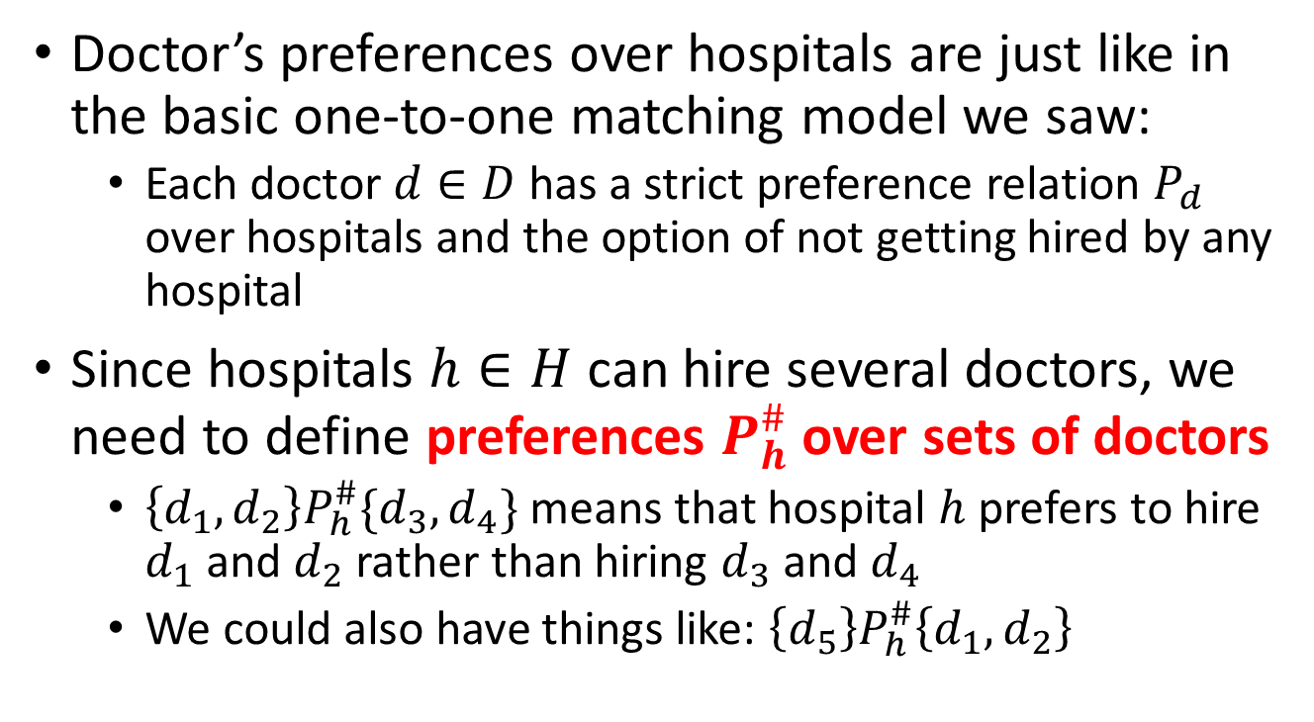
Preferences
Doctor’s preferences over hospitals are just like in the basic one-to-one matching model we saw:
  Each doctor $d∈D$ has a strict preference relation $P_{d}$ over hospitals and the option of not getting hired by any hospital
Since hospitals $h∈H$ can hire several doctors, we need to define preferences $P_{h}^{\#}$ over sets of doctors
  $\left\{d_{1},d_{2}\right\}P_{h}^{\#}\{d_{3},d_{4}\}$ means that hospital $h$ prefers to hire $d_{1}$ and $d_{2}$ rather than hiring $d_{3}$ and $d_{4}$
  We could also have things like: $\left\{d_{5}\right\}P_{h}^{\#}\left\{d_{1},d_{2}\right\}$

Slide 15
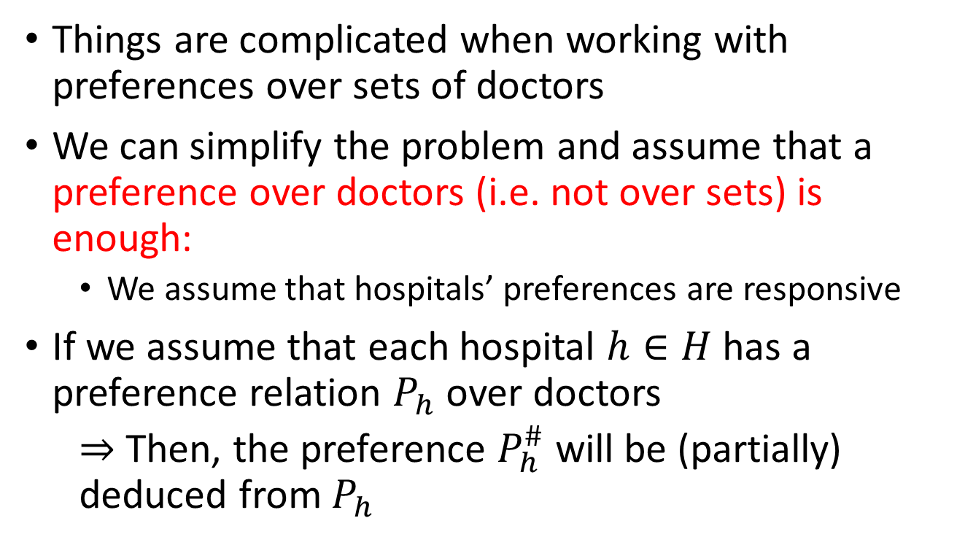
Responsive Preferences
Things are complicated when working with preferences over sets of doctors
We can simplify the problem and assume that a preference over doctors (i.e. not over sets) is enough:
  We assume that hospitals’ preferences are responsive
If we assume that each hospital $h∈H$ has a preference relation $P_{h}$ over doctors
  $⇒$ Then, the preference $P_{h}^{\#}$ will be (partially) deduced from $P_{h}$

Slide 16
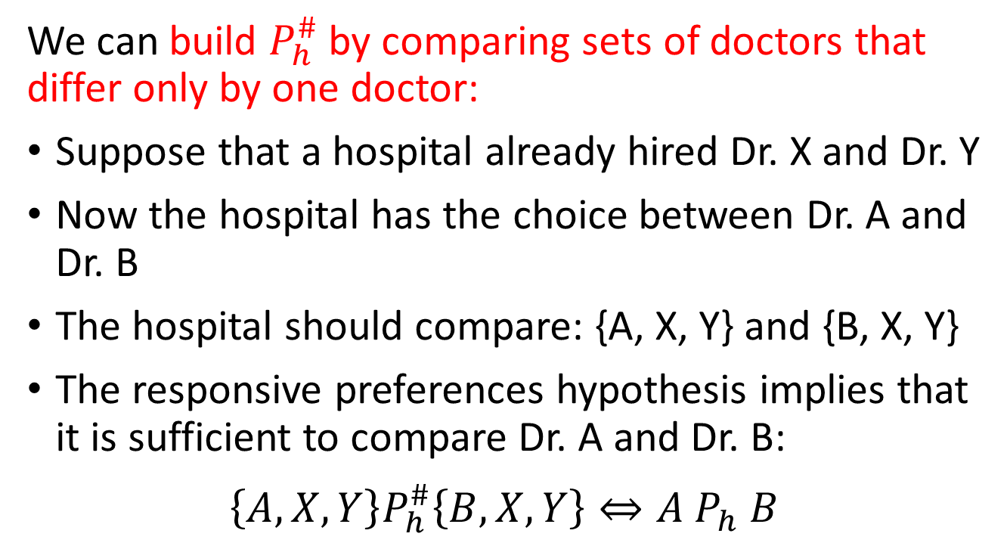
Responsive Preferences
We can build $P_{h}^{\#}$ by comparing sets of doctors that differ only by one doctor:
Suppose that a hospital already hired Dr. X and Dr. Y
Now the hospital has the choice between Dr. A and Dr. B
The hospital should compare: {A, X, Y} and {B, X, Y}
The responsive preferences hypothesis implies that it is sufficient to compare Dr. A and Dr. B:
$$\left\{A,X,Y\right\}P_{h}^{\#}\left\{B,X,Y\right\}⇔A P_{h} B$$

Slide 17
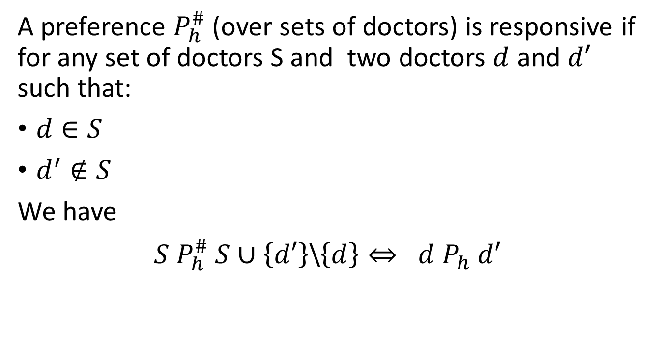
Definition: Responsive Preference
A preference $P_{h}^{\#}$ (over sets of doctors) is responsive if for any set of doctors S and two doctors $d$ and $d′$ such that:
$d∈S$
$d^{′}∉S$
We have
$S P_{h}^{\#} S∪\left\{d′\right\}$\$\left\{d\right\}⇔ d P_{h} d′$
d’ added to S
and d withdrawn from S
(Or we are swapping d for d’ in S)

Slide 18
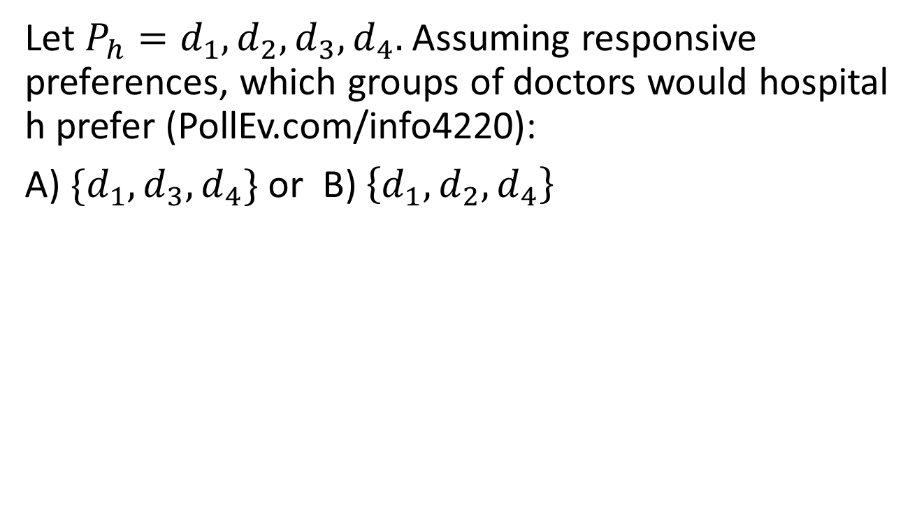
PollEV Question
Let $P_{h}=d_{1},d_{2},d_{3},d_{4}.$Assuming responsive preferences, which groups of doctors would hospital h prefer (PollEv.com/info4220):
A) $\{d_{1},d_{3},d_{4}\}$ or B) $\left\{d_{1},d_{2},d_{4}\right\}$

Slide 19
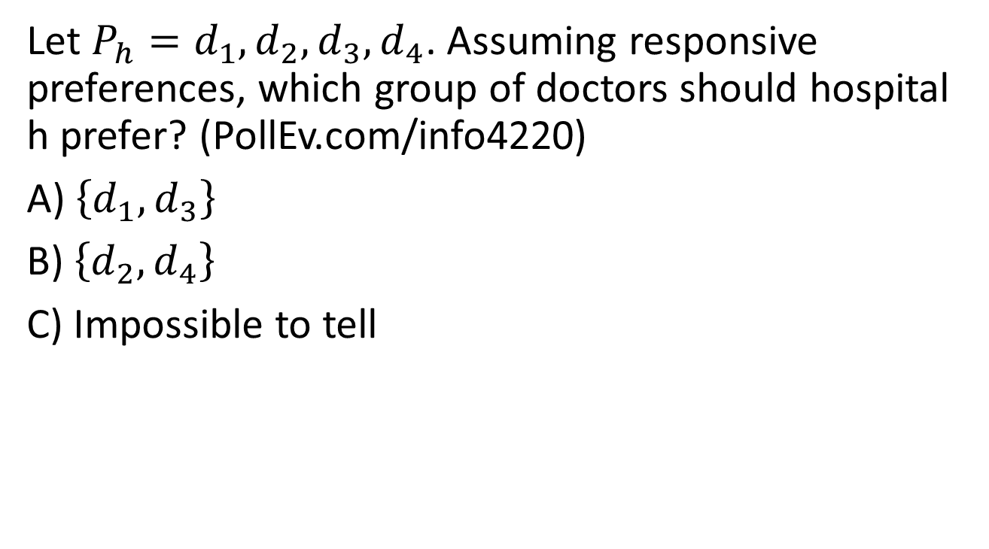
PollEV Question
Let $P_{h}=d_{1},d_{2},d_{3},d_{4}$. Assuming responsive preferences, which group of doctors should hospital h prefer? (PollEv.com/info4220)
A) $\left\{d_{1},d_{3}\right\}$
B) $\left\{d_{2},d_{4}\right\}$
C) Impossible to tell

Slide 20
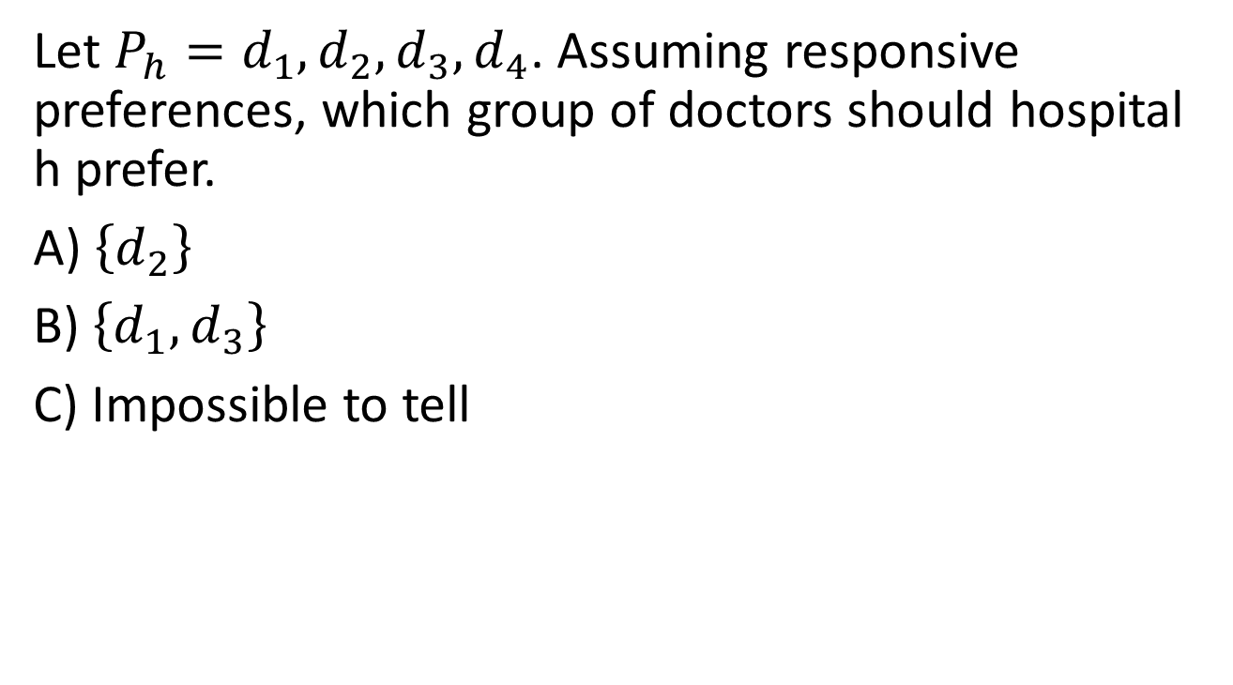
PollEV Question
Let $P_{h}=d_{1},d_{2},d_{3},d_{4}$. Assuming responsive preferences, which group of doctors should hospital h prefer.
A) $\left\{d_{2}\right\}$
B) $\left\{d_{1},d_{3}\right\}$
C) Impossible to tell

Slide 21
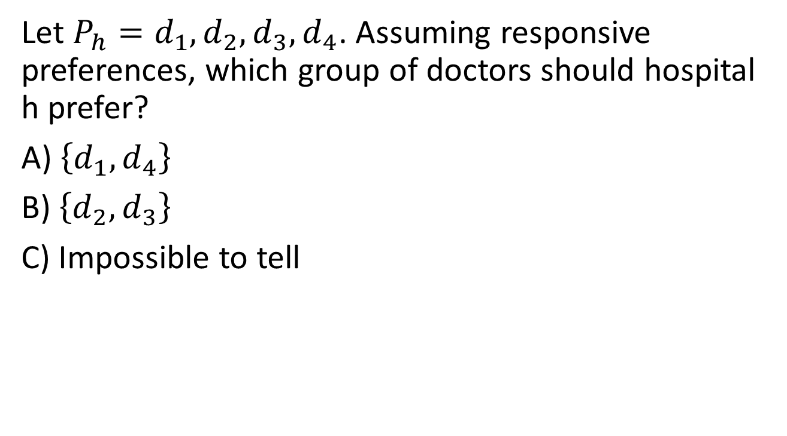
Example
Let $P_{h}=d_{1},d_{2},d_{3},d_{4}$. Assuming responsive preferences, which group of doctors should hospital h prefer?
A)$\left\{d_{1},d_{4}\right\}$
B) $\left\{d_{2},d_{3}\right\}$
C) Impossible to tell

Slide 22
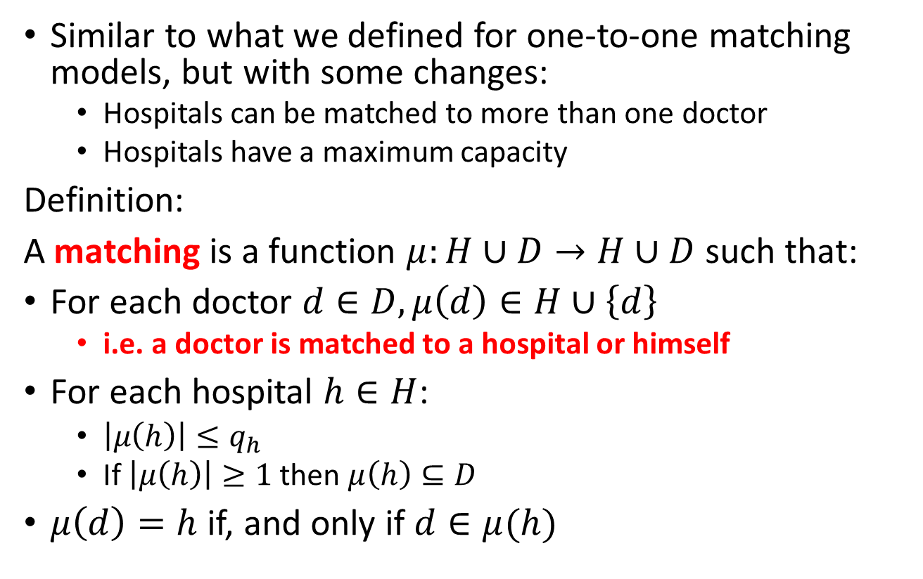
Matching
Similar to what we defined for one-to-one matching models, but with some changes:
  Hospitals can be matched to more than one doctor
  Hospitals have a maximum capacity
Definition:
A matching is a function $μ:H∪D→H∪D$ such that:
For each doctor $d∈D,μ\left(d\right)∈H∪\left\{d\right\}$
  i.e. a doctor is matched to a hospital or himself
For each hospital $h∈H$:
  $\left|μ\left(h\right)\right|≤q_{h}$
  If $\left|μ\left(h\right)\right|≥1$ then $μ\left(h\right)⊆D$
$μ\left(d\right)=h$ if, and only if $d∈μ(h)$
A hospital’s match cannot exceed its capacity and a hospital is matched to doctors

Slide 23
Stability
In a many-to-one matching problem, stability is defined by three requirements:
Individual rationality
Absence of blocking pairs
Non-wastefulness

Slide 24
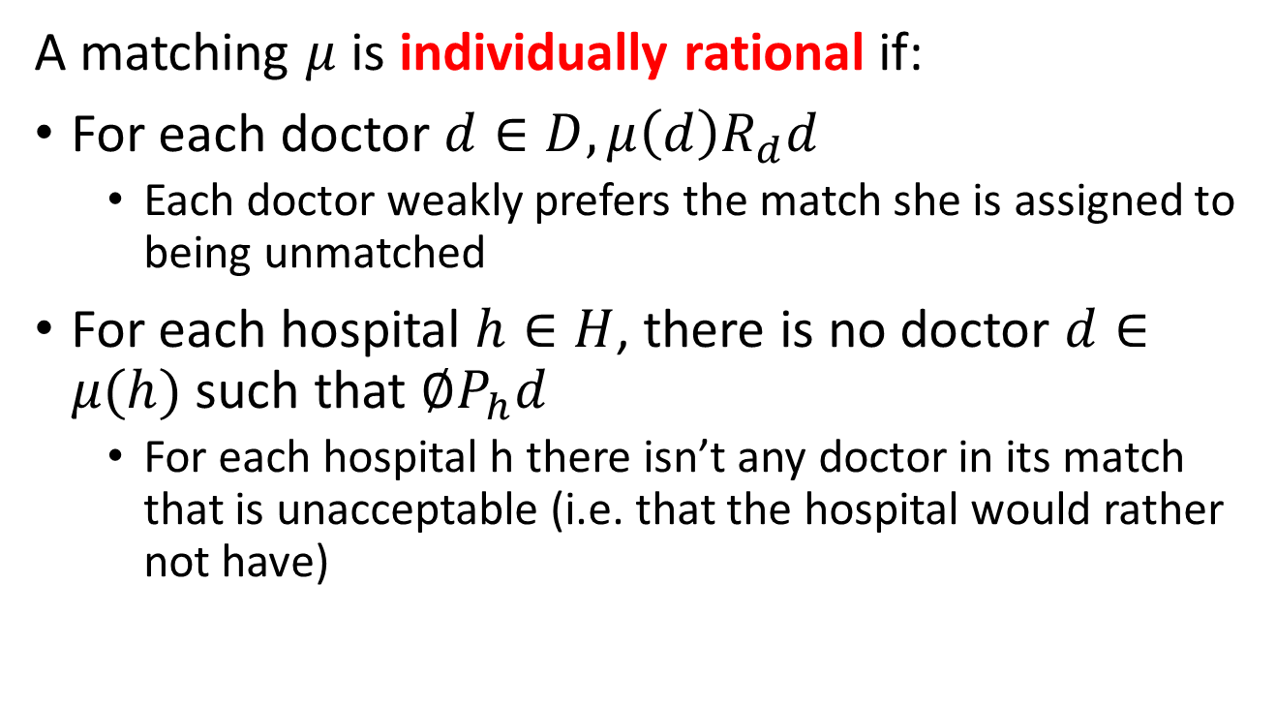
Individual Rationality
A matching $μ$ is individually rational if:
For each doctor $d∈D, μ\left(d\right)R_{d}d$
  Each doctor weakly prefers the match she is assigned to being unmatched
For each hospital $h∈H$, there is no doctor $d∈μ(h)$ such that $∅P_{h}d$
  For each hospital h there isn’t any doctor in its match that is unacceptable (i.e. that the hospital would rather not have)

Slide 25








Meadowridge Hospital
(Capacity = 2)
Skyline Hospital
(Capacity = 2)
Orange County Hospital
(Capacity = 2)
I would rather be unemployed
Dr. Goldberg
Dr. Gray
Dr. Lilac
Dr. Greene
Dr. Smith
Not individually rational: Dr. Goldberg would prefer to be unmatched rather than working at Meadowridge

Slide 26
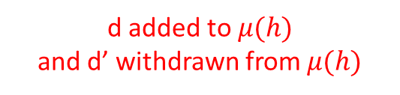
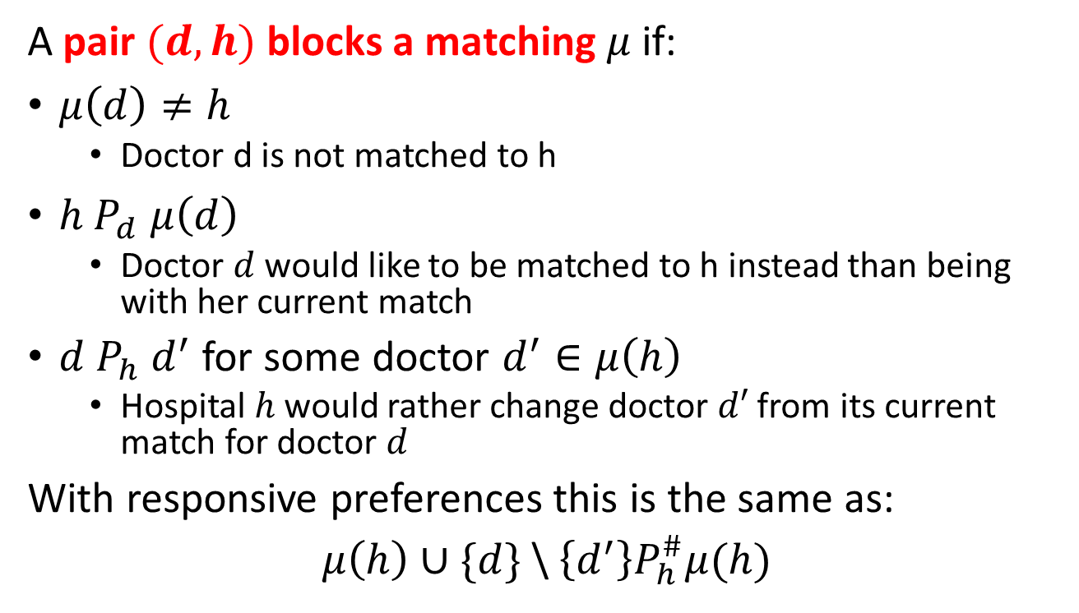
Blocking Pairs
A pair $(d, h)$ blocks a matching $μ$ if:
$μ\left(d\right)≠h$
  Doctor d is not matched to h
$h P_{d} μ\left(d\right)$
  Doctor $d$ would like to be matched to h instead than being with her current match
$d P_{h} d^{′}$ for some doctor $d^{′}∈μ\left(h\right)$
  Hospital $h$ would rather change doctor $d′$ from its current match for doctor $d$
With responsive preferences this is the same as:
$μ\left(h\right)∪\{d\}$\ $\left\{d^{′}\right\}P_{h}^{\#}μ(h)$
d added to $μ(h)$
and d’ withdrawn from $μ(h)$

Slide 27
Meadowridge Hospital
(Capacity = 2)
Skyline Hospital
(Capacity = 2)
Orange County Hospital
(Capacity = 2)
Dr. Goldberg
Dr. Gray
Dr. Lilac
Dr. Greene
Dr. Smith
Dr. Goldberg and Skyline Hospital are a Blocking Pair: They are not matched to each other, and they would each prefer to be matched to each other rather than their current match (Let’s say, for example, Skyline Hospital likes Dr. Goldberg better than Dr. Lilac)

Slide 28
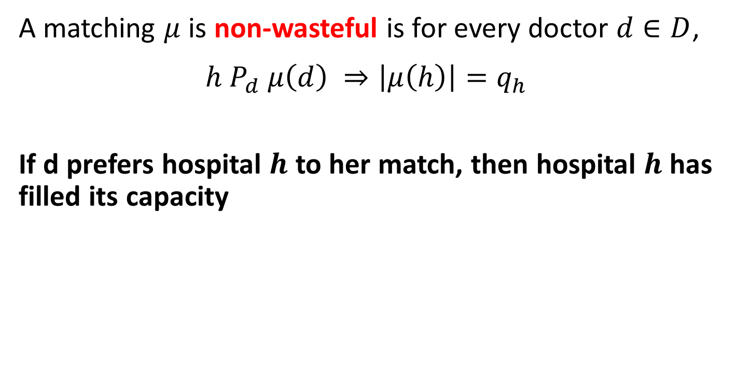
Non-wastefulness
A matching $μ$ is non-wasteful is for every doctor $d∈D$,
$$h P_{d} μ\left(d\right) ⇒\left|μ\left(h\right)\right|=q_{h}$$
If d prefers hospital $h$ to her match, then hospital $h$ has filled its capacity

Slide 29
Meadowridge Hospital
(Capacity = 2)
Skyline Hospital
(Capacity = 2)
Orange County Hospital
(Capacity = 2)
Dr. Goldberg
Dr. Gray
Dr. Lilac
Dr. Greene
Dr. Ochre
Wasteful: Dr. Lilac would prefer to work at the Orange County Hospital rather than at Skyline, and Orange County is not full and does not find Dr. Lilac unacceptable

Slide 30
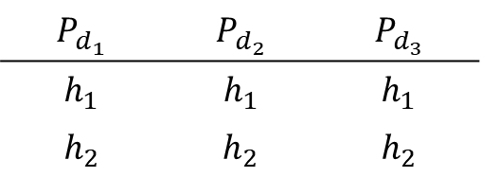
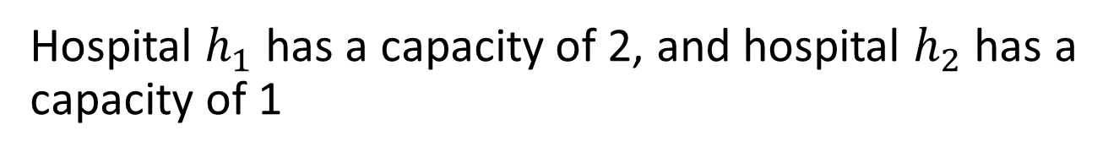
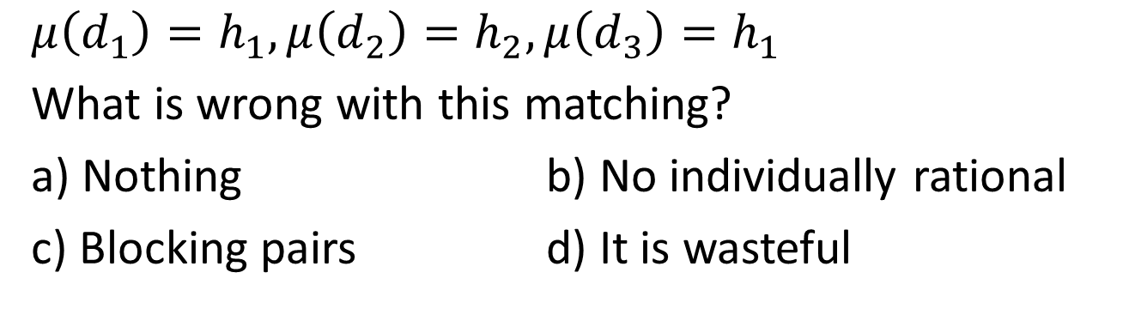
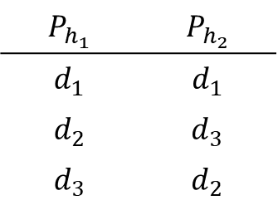
PollEV Question
Hospital $h_{1}$ has a capacity of 2, and hospital $h_{2}$ has a capacity of 1
$$P_{d_{1}}$$ | $$P_{d_{2}}$$ | $$P_{d_{3}}$$
$$h_{1}$$ | $$h_{1}$$ | $$h_{1}$$
$$h_{2}$$ | $$h_{2}$$ | $$h_{2}$$
$$P_{h_{1}}$$ | $$P_{h_{2}}$$
$$d_{1}$$ | $$d_{1}$$
$$d_{2}$$ | $$d_{3}$$
$$d_{3}$$ | $$d_{2}$$
$$μ\left(d_{1}\right)=h_{1},μ\left(d_{2}\right)=h_{2},μ\left(d_{3}\right)=h_{1}$$
What is wrong with this matching?
a) Nothing b) No individually rational
c) Blocking pairs d) It is wasteful

Slide 31
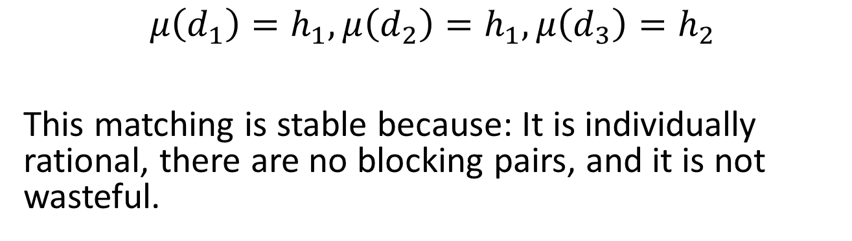
Example
Hospital $h_{1}$ has a capacity of 2, and hospital $h_{2}$ has a capacity of 1
$$P_{d_{1}}$$ | $$P_{d_{2}}$$ | $$P_{d_{3}}$$
$$h_{1}$$ | $$h_{1}$$ | $$h_{1}$$
$$h_{2}$$ | $$h_{2}$$ | $$h_{2}$$
$$P_{h_{1}}$$ | $$P_{h_{2}}$$
$$d_{1}$$ | $$d_{1}$$
$$d_{2}$$ | $$d_{3}$$
$$d_{3}$$ | $$d_{2}$$
$$μ\left(d_{1}\right)=h_{1},μ\left(d_{2}\right)=h_{1},μ\left(d_{3}\right)=h_{2}$$
This matching is stable because: It is individually rational, there are no blocking pairs, and it is not wasteful.

Slide 32
Deferred Acceptance Algorithm
The DA can be used to obtain a stable matching
Like in the one-to-one case, there are two versions:
  Doctors propose, and hospitals accepts/rejects proposal
  Hospitals propose, and doctors accepts/rejects proposal
The version where doctors propose is similar to the one-to-one version, with the difference that hospitals can hold multiple offers (up to capacity)
At any step in the algorithm, the hospitals evaluate:
  The set of doctors it is holding from previous steps (if any)
  The set of doctors who made an offer in current time (if any)
From this set, the hospital accepts doctors up to its capacity, one at a time starting with the most preferred

Slide 33
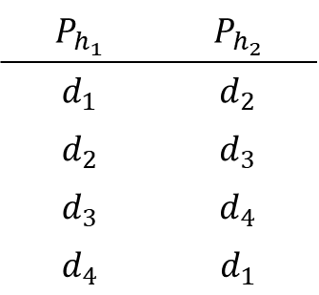
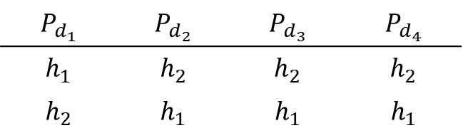
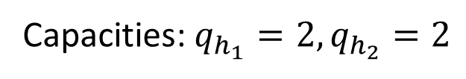
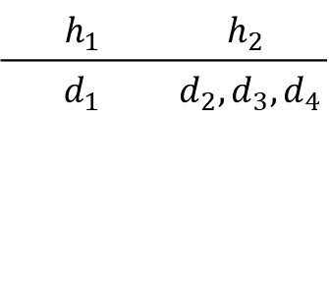
Example: DA with Doctors Proposing
Capacities: $q_{h_{1}}=2, q_{h_{2}}=2$
$$P_{d_{1}}$$ | $$P_{d_{2}}$$ | $$P_{d_{3}}$$ | $$P_{d_{4}}$$
$$h_{1}$$ | $$h_{2}$$ | $$h_{2}$$ | $$h_{2}$$
$$h_{2}$$ | $$h_{1}$$ | $$h_{1}$$ | $$h_{1}$$
$$P_{h_{1}}$$ | $$P_{h_{2}}$$
$$d_{1}$$ | $$d_{2}$$
$$d_{2}$$ | $$d_{3}$$
$$d_{3}$$ | $$d_{4}$$
$$d_{4}$$ | $$d_{1}$$
Step 1:
Each doctor proposes to their most preferred hospital
$$h_{1}$$ | $$h_{2}$$
$$d_{1}$$ | $$d_{2},d_{3},d_{4}$$

Slide 34
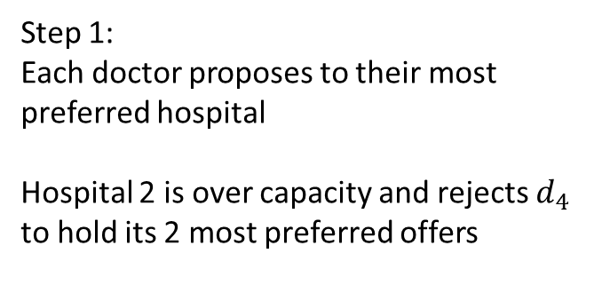
Example: DA with Doctors Proposing
Capacities: $q_{h_{1}}=2, q_{h_{2}}=2$
$$P_{d_{1}}$$ | $$P_{d_{2}}$$ | $$P_{d_{3}}$$ | $$P_{d_{4}}$$
$$h_{1}$$ | $$h_{2}$$ | $$h_{2}$$ | $$h_{2}$$
$$h_{2}$$ | $$h_{1}$$ | $$h_{1}$$ | $$h_{1}$$
$$P_{h_{1}}$$ | $$P_{h_{2}}$$
$$d_{1}$$ | $$d_{2}$$
$$d_{2}$$ | $$d_{3}$$
$$d_{3}$$ | $$d_{4}$$
$$d_{4}$$ | $$d_{1}$$
Step 1:
Each doctor proposes to their most preferred hospital
Hospital 2 is over capacity and rejects $d_{4}$ to hold its 2 most preferred offers
$$h_{1}$$ | $$h_{2}$$
$$d_{1}$$ | $$d_{2},d_{3},d_{4}$$

Slide 35
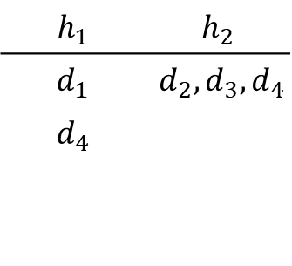
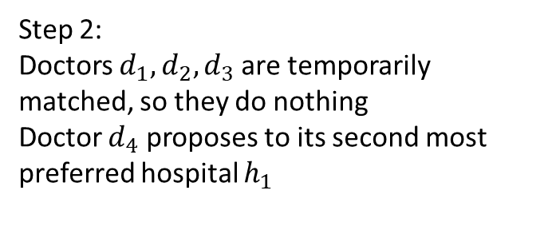
Example: DA with Doctors Proposing
Capacities: $q_{h_{1}}=2, q_{h_{2}}=2$
$$P_{d_{1}}$$ | $$P_{d_{2}}$$ | $$P_{d_{3}}$$ | $$P_{d_{4}}$$
$$h_{1}$$ | $$h_{2}$$ | $$h_{2}$$ | $$h_{2}$$
$$h_{2}$$ | $$h_{1}$$ | $$h_{1}$$ | $$h_{1}$$
$$P_{h_{1}}$$ | $$P_{h_{2}}$$
$$d_{1}$$ | $$d_{2}$$
$$d_{2}$$ | $$d_{3}$$
$$d_{3}$$ | $$d_{4}$$
$$d_{4}$$ | $$d_{1}$$
Step 2:
Doctors $d_{1},d_{2}, d_{3}$ are temporarily matched, so they do nothing
Doctor $d_{4}$ proposes to its second most preferred hospital $h_{1}$
$$h_{1}$$ | $$h_{2}$$
$$d_{1}$$ | $$d_{2},d_{3},d_{4}$$
$$d_{4}$$

Slide 36
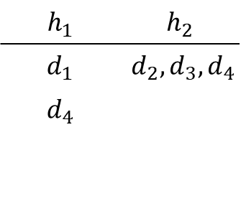
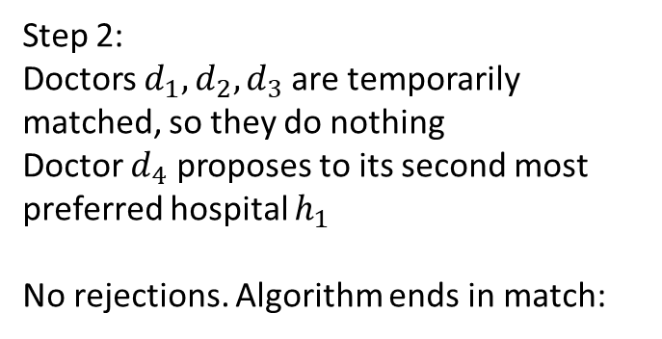
Example: DA with Doctors Proposing
Capacities: $q_{h_{1}}=2, q_{h_{2}}=2$
$$P_{d_{1}}$$ | $$P_{d_{2}}$$ | $$P_{d_{3}}$$ | $$P_{d_{4}}$$
$$h_{1}$$ | $$h_{2}$$ | $$h_{2}$$ | $$h_{2}$$
$$h_{2}$$ | $$h_{1}$$ | $$h_{1}$$ | $$h_{1}$$
$$P_{h_{1}}$$ | $$P_{h_{2}}$$
$$d_{1}$$ | $$d_{2}$$
$$d_{2}$$ | $$d_{3}$$
$$d_{3}$$ | $$d_{4}$$
$$d_{4}$$ | $$d_{1}$$
Step 2:
Doctors $d_{1},d_{2}, d_{3}$ are temporarily matched, so they do nothing
Doctor $d_{4}$ proposes to its second most preferred hospital $h_{1}$
No rejections. Algorithm ends in match:
$$h_{1}$$ | $$h_{2}$$
$$d_{1}$$ | $$d_{2},d_{3},d_{4}$$
$$d_{4}$$
$$μ\left(d_{1}\right)=h_{1},μ\left(d_{2}\right)=h_{2},μ\left(d_{3}\right)=h_{2}, μ\left(d_{4}\right)=h_{1}$$

Slide 37
DA with Hospitals Proposing
We have to introduce more changes with respect to the one-to-one matching. Now hospitals can make multiple proposals per step:
Step 1:
Each hospital proposes to its most preferred set of doctors
Each doctor rejects all hospitals except for the most preferred acceptable hospital that proposed to her

Slide 38
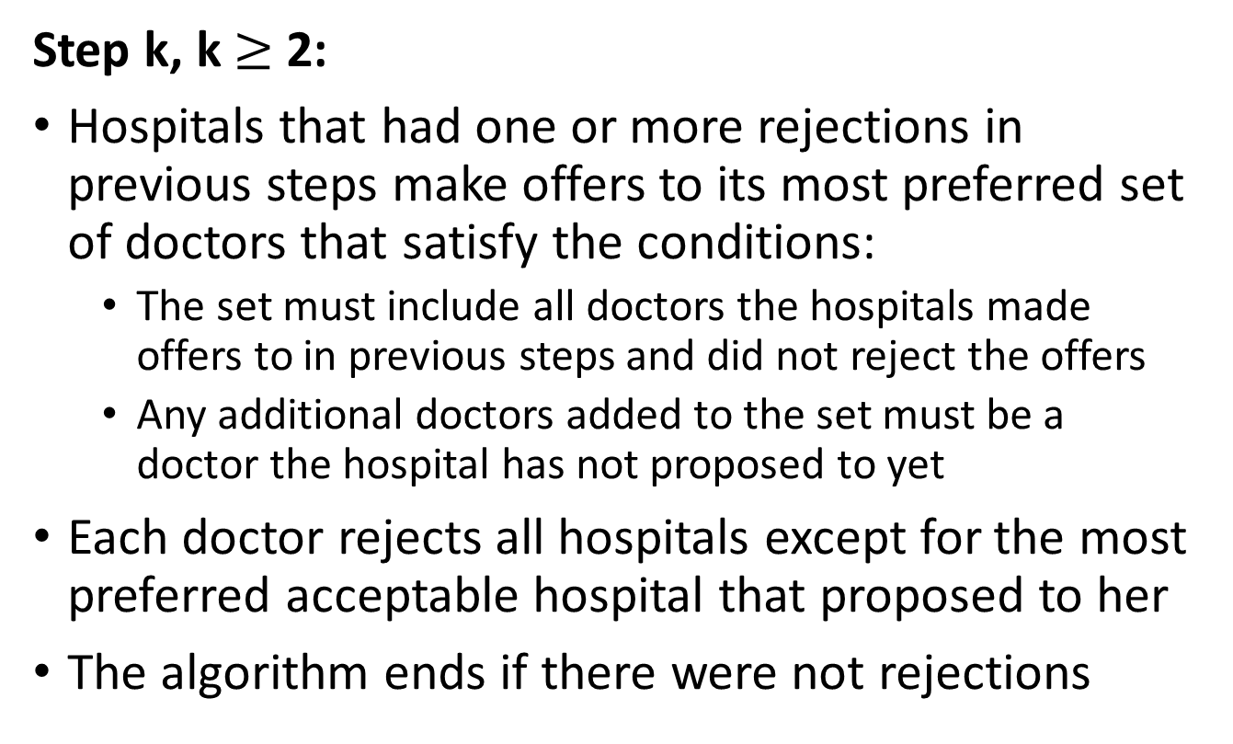
DA with Hospitals Proposing
Step k, k $≥$ 2:
Hospitals that had one or more rejections in previous steps make offers to its most preferred set of doctors that satisfy the conditions:
  The set must include all doctors the hospitals made offers to in previous steps and did not reject the offers
  Any additional doctors added to the set must be a doctor the hospital has not proposed to yet
Each doctor rejects all hospitals except for the most preferred acceptable hospital that proposed to her
The algorithm ends if there were not rejections

Slide 39
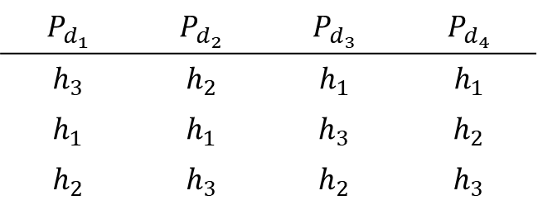
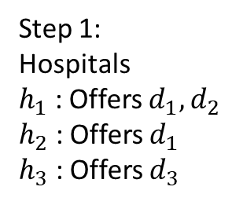
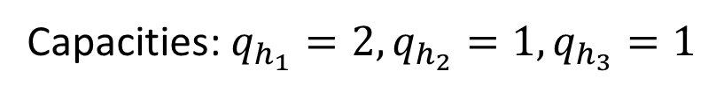
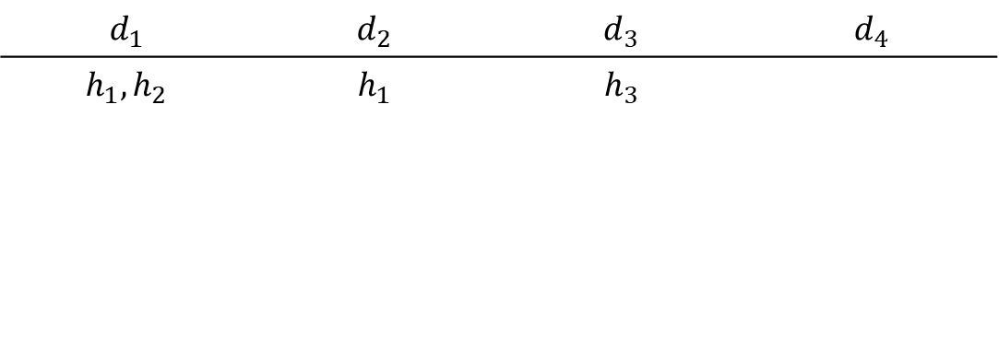
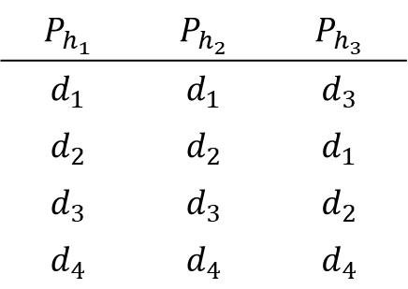
Exercise: DA with Hospitals Proposing
Capacities: $q_{h_{1}}=2, q_{h_{2}}=1,q_{h_{3}}=1$
$$P_{d_{1}}$$ | $$P_{d_{2}}$$ | $$P_{d_{3}}$$ | $$P_{d_{4}}$$
$$h_{3}$$ | $$h_{2}$$ | $$h_{1}$$ | $$h_{1}$$
$$h_{1}$$ | $$h_{1}$$ | $$h_{3}$$ | $$h_{2}$$
$$h_{2}$$ | $$h_{3}$$ | $$h_{2}$$ | $$h_{3}$$
$$P_{h_{1}}$$ | $$P_{h_{2}}$$ | $$P_{h_{3}}$$
$$d_{1}$$ | $$d_{1}$$ | $$d_{3}$$
$$d_{2}$$ | $$d_{2}$$ | $$d_{1}$$
$$d_{3}$$ | $$d_{3}$$ | $$d_{2}$$
$$d_{4}$$ | $$d_{4}$$ | $$d_{4}$$
$$d_{1}$$ | $$d_{2}$$ | $$d_{3}$$ | $$d_{4}$$
$$h_{1},h_{2}$$ | $$h_{1}$$ | $$h_{3}$$
Step 1:
Hospitals
$h_{1}$ : Offers $d_{1}, d_{2}$
$h_{2}$ : Offers $d_{1}$
$h_{3}$ : Offers $d_{3}$

Slide 40
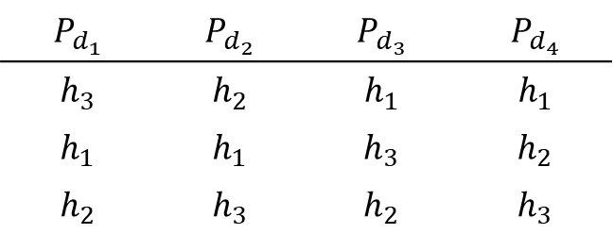
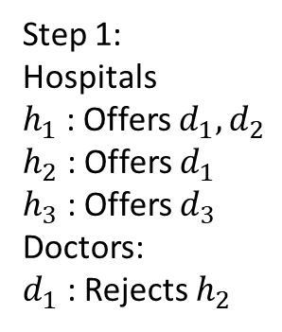
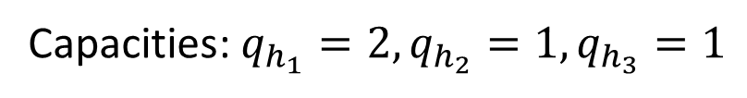
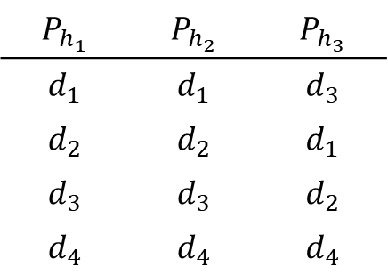
Exercise: DA with Hospitals Proposing
Capacities: $q_{h_{1}}=2, q_{h_{2}}=1,q_{h_{3}}=1$
$$P_{d_{1}}$$ | $$P_{d_{2}}$$ | $$P_{d_{3}}$$ | $$P_{d_{4}}$$
$$h_{3}$$ | $$h_{2}$$ | $$h_{1}$$ | $$h_{1}$$
$$h_{1}$$ | $$h_{1}$$ | $$h_{3}$$ | $$h_{2}$$
$$h_{2}$$ | $$h_{3}$$ | $$h_{2}$$ | $$h_{3}$$
$$P_{h_{1}}$$ | $$P_{h_{2}}$$ | $$P_{h_{3}}$$
$$d_{1}$$ | $$d_{1}$$ | $$d_{3}$$
$$d_{2}$$ | $$d_{2}$$ | $$d_{1}$$
$$d_{3}$$ | $$d_{3}$$ | $$d_{2}$$
$$d_{4}$$ | $$d_{4}$$ | $$d_{4}$$
$$d_{1}$$ | $$d_{2}$$ | $$d_{3}$$ | $$d_{4}$$
$$h_{1},h_{2}$$ | $$h_{1}$$ | $$h_{3}$$
Step 1:
Hospitals
$h_{1}$ : Offers $d_{1}, d_{2}$
$h_{2}$ : Offers $d_{1}$
$h_{3}$ : Offers $d_{3}$
Doctors:
$d_{1}$ : Rejects $h_{2}$

Slide 41
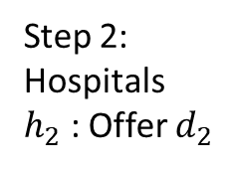
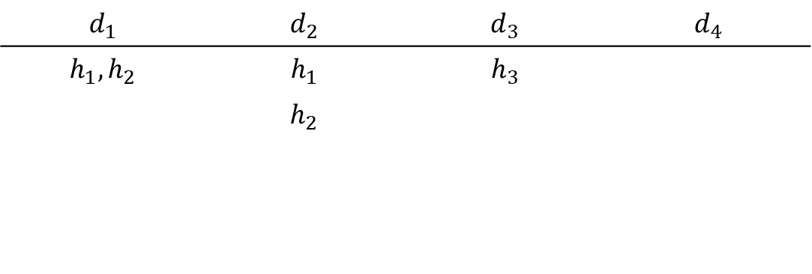
Exercise: DA with Hospitals Proposing
Capacities: $q_{h_{1}}=2, q_{h_{2}}=1,q_{h_{3}}=1$
$$P_{d_{1}}$$ | $$P_{d_{2}}$$ | $$P_{d_{3}}$$ | $$P_{d_{4}}$$
$$h_{3}$$ | $$h_{2}$$ | $$h_{1}$$ | $$h_{1}$$
$$h_{1}$$ | $$h_{1}$$ | $$h_{3}$$ | $$h_{2}$$
$$h_{2}$$ | $$h_{3}$$ | $$h_{2}$$ | $$h_{3}$$
$$P_{h_{1}}$$ | $$P_{h_{2}}$$ | $$P_{h_{3}}$$
$$d_{1}$$ | $$d_{1}$$ | $$d_{3}$$
$$d_{2}$$ | $$d_{2}$$ | $$d_{1}$$
$$d_{3}$$ | $$d_{3}$$ | $$d_{2}$$
$$d_{4}$$ | $$d_{4}$$ | $$d_{4}$$
$$d_{1}$$ | $$d_{2}$$ | $$d_{3}$$ | $$d_{4}$$
$$h_{1},h_{2}$$ | $$h_{1}$$ | $$h_{3}$$
 | $$h_{2}$$
Step 2:
Hospitals
$h_{2}$ : Offer $d_{2}$

Slide 42
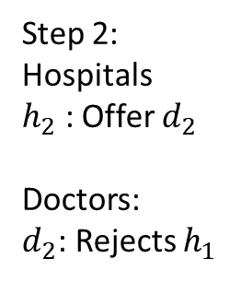
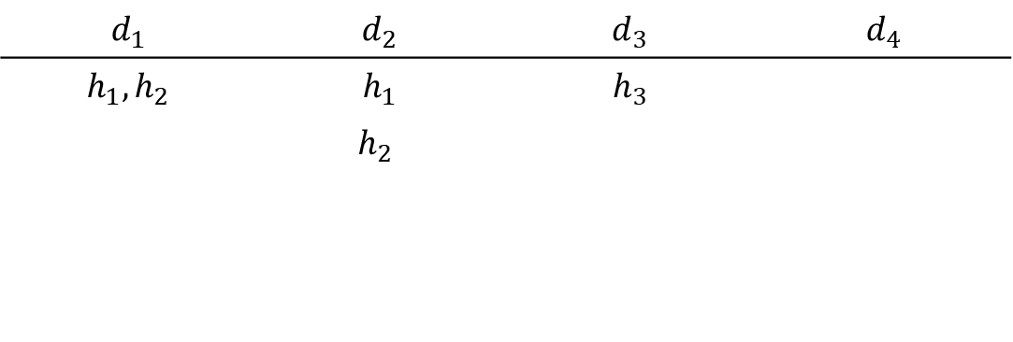
Exercise: DA with Hospitals Proposing
Capacities: $q_{h_{1}}=2, q_{h_{2}}=1,q_{h_{3}}=1$
$$P_{d_{1}}$$ | $$P_{d_{2}}$$ | $$P_{d_{3}}$$ | $$P_{d_{4}}$$
$$h_{3}$$ | $$h_{2}$$ | $$h_{1}$$ | $$h_{1}$$
$$h_{1}$$ | $$h_{1}$$ | $$h_{3}$$ | $$h_{2}$$
$$h_{2}$$ | $$h_{3}$$ | $$h_{2}$$ | $$h_{3}$$
$$P_{h_{1}}$$ | $$P_{h_{2}}$$ | $$P_{h_{3}}$$
$$d_{1}$$ | $$d_{1}$$ | $$d_{3}$$
$$d_{2}$$ | $$d_{2}$$ | $$d_{1}$$
$$d_{3}$$ | $$d_{3}$$ | $$d_{2}$$
$$d_{4}$$ | $$d_{4}$$ | $$d_{4}$$
$$d_{1}$$ | $$d_{2}$$ | $$d_{3}$$ | $$d_{4}$$
$$h_{1},h_{2}$$ | $$h_{1}$$ | $$h_{3}$$
 | $$h_{2}$$
Step 2:
Hospitals
$h_{2}$ : Offer $d_{2}$
Doctors:
$d_{2}$: Rejects $h_{1}$

Slide 43
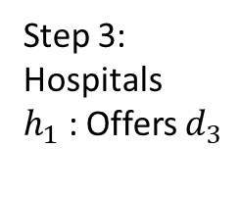
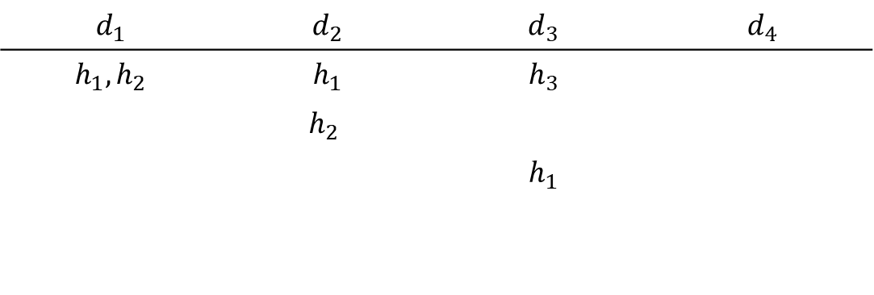
Exercise: DA with Hospitals Proposing
Capacities: $q_{h_{1}}=2, q_{h_{2}}=1,q_{h_{3}}=1$
$$P_{d_{1}}$$ | $$P_{d_{2}}$$ | $$P_{d_{3}}$$ | $$P_{d_{4}}$$
$$h_{3}$$ | $$h_{2}$$ | $$h_{1}$$ | $$h_{1}$$
$$h_{1}$$ | $$h_{1}$$ | $$h_{3}$$ | $$h_{2}$$
$$h_{2}$$ | $$h_{3}$$ | $$h_{2}$$ | $$h_{3}$$
$$P_{h_{1}}$$ | $$P_{h_{2}}$$ | $$P_{h_{3}}$$
$$d_{1}$$ | $$d_{1}$$ | $$d_{3}$$
$$d_{2}$$ | $$d_{2}$$ | $$d_{1}$$
$$d_{3}$$ | $$d_{3}$$ | $$d_{2}$$
$$d_{4}$$ | $$d_{4}$$ | $$d_{4}$$
$$d_{1}$$ | $$d_{2}$$ | $$d_{3}$$ | $$d_{4}$$
$$h_{1},h_{2}$$ | $$h_{1}$$ | $$h_{3}$$
 | $$h_{2}$$
 |  | $$h_{1}$$
Step 3:
Hospitals
$h_{1}$ : Offers $d_{3}$

Slide 44
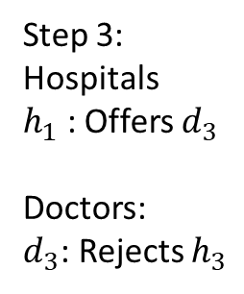
Exercise: DA with Hospitals Proposing
Capacities: $q_{h_{1}}=2, q_{h_{2}}=1,q_{h_{3}}=1$
$$P_{d_{1}}$$ | $$P_{d_{2}}$$ | $$P_{d_{3}}$$ | $$P_{d_{4}}$$
$$h_{3}$$ | $$h_{2}$$ | $$h_{1}$$ | $$h_{1}$$
$$h_{1}$$ | $$h_{1}$$ | $$h_{3}$$ | $$h_{2}$$
$$h_{2}$$ | $$h_{3}$$ | $$h_{2}$$ | $$h_{3}$$
$$P_{h_{1}}$$ | $$P_{h_{2}}$$ | $$P_{h_{3}}$$
$$d_{1}$$ | $$d_{1}$$ | $$d_{3}$$
$$d_{2}$$ | $$d_{2}$$ | $$d_{1}$$
$$d_{3}$$ | $$d_{3}$$ | $$d_{2}$$
$$d_{4}$$ | $$d_{4}$$ | $$d_{4}$$
$$d_{1}$$ | $$d_{2}$$ | $$d_{3}$$ | $$d_{4}$$
$$h_{1},h_{2}$$ | $$h_{1}$$ | $$h_{3}$$
 | $$h_{2}$$
 |  | $$h_{1}$$
Step 3:
Hospitals
$h_{1}$ : Offers $d_{3}$
Doctors:
$d_{3}$: Rejects $h_{3}$

Slide 45
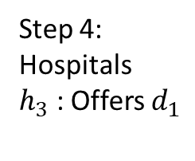
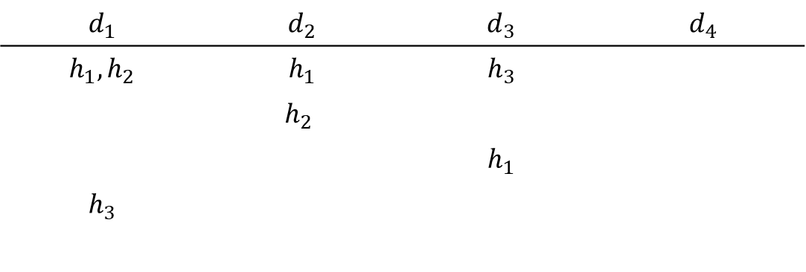
Exercise: DA with Hospitals Proposing
Capacities: $q_{h_{1}}=2, q_{h_{2}}=1,q_{h_{3}}=1$
$$P_{d_{1}}$$ | $$P_{d_{2}}$$ | $$P_{d_{3}}$$ | $$P_{d_{4}}$$
$$h_{3}$$ | $$h_{2}$$ | $$h_{1}$$ | $$h_{1}$$
$$h_{1}$$ | $$h_{1}$$ | $$h_{3}$$ | $$h_{2}$$
$$h_{2}$$ | $$h_{3}$$ | $$h_{2}$$ | $$h_{3}$$
$$P_{h_{1}}$$ | $$P_{h_{2}}$$ | $$P_{h_{3}}$$
$$d_{1}$$ | $$d_{1}$$ | $$d_{3}$$
$$d_{2}$$ | $$d_{2}$$ | $$d_{1}$$
$$d_{3}$$ | $$d_{3}$$ | $$d_{2}$$
$$d_{4}$$ | $$d_{4}$$ | $$d_{4}$$
$$d_{1}$$ | $$d_{2}$$ | $$d_{3}$$ | $$d_{4}$$
$$h_{1},h_{2}$$ | $$h_{1}$$ | $$h_{3}$$
 | $$h_{2}$$
 |  | $$h_{1}$$
$$h_{3}$$
Step 4:
Hospitals
$h_{3}$ : Offers $d_{1}$

Slide 46
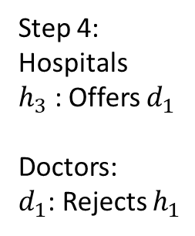
Exercise: DA with Hospitals Proposing
Capacities: $q_{h_{1}}=2, q_{h_{2}}=1,q_{h_{3}}=1$
$$P_{d_{1}}$$ | $$P_{d_{2}}$$ | $$P_{d_{3}}$$ | $$P_{d_{4}}$$
$$h_{3}$$ | $$h_{2}$$ | $$h_{1}$$ | $$h_{1}$$
$$h_{1}$$ | $$h_{1}$$ | $$h_{3}$$ | $$h_{2}$$
$$h_{2}$$ | $$h_{3}$$ | $$h_{2}$$ | $$h_{3}$$
$$P_{h_{1}}$$ | $$P_{h_{2}}$$ | $$P_{h_{3}}$$
$$d_{1}$$ | $$d_{1}$$ | $$d_{3}$$
$$d_{2}$$ | $$d_{2}$$ | $$d_{1}$$
$$d_{3}$$ | $$d_{3}$$ | $$d_{2}$$
$$d_{4}$$ | $$d_{4}$$ | $$d_{4}$$
$$d_{1}$$ | $$d_{2}$$ | $$d_{3}$$ | $$d_{4}$$
$$h_{1},h_{2}$$ | $$h_{1}$$ | $$h_{3}$$
 | $$h_{2}$$
 |  | $$h_{1}$$
$$h_{3}$$
Step 4:
Hospitals
$h_{3}$ : Offers $d_{1}$
Doctors:
$d_{1}$: Rejects $h_{1}$

Slide 47
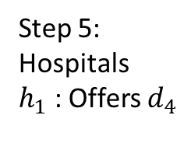

Exercise: DA with Hospitals Proposing
Capacities: $q_{h_{1}}=2, q_{h_{2}}=1,q_{h_{3}}=1$
$$P_{d_{1}}$$ | $$P_{d_{2}}$$ | $$P_{d_{3}}$$ | $$P_{d_{4}}$$
$$h_{3}$$ | $$h_{2}$$ | $$h_{1}$$ | $$h_{1}$$
$$h_{1}$$ | $$h_{1}$$ | $$h_{3}$$ | $$h_{2}$$
$$h_{2}$$ | $$h_{3}$$ | $$h_{2}$$ | $$h_{3}$$
$$P_{h_{1}}$$ | $$P_{h_{2}}$$ | $$P_{h_{3}}$$
$$d_{1}$$ | $$d_{1}$$ | $$d_{3}$$
$$d_{2}$$ | $$d_{2}$$ | $$d_{1}$$
$$d_{3}$$ | $$d_{3}$$ | $$d_{2}$$
$$d_{4}$$ | $$d_{4}$$ | $$d_{4}$$
$$d_{1}$$ | $$d_{2}$$ | $$d_{3}$$ | $$d_{4}$$
$$h_{1},h_{2}$$ | $$h_{1}$$ | $$h_{3}$$
 | $$h_{2}$$
 |  | $$h_{1}$$
$$h_{3}$$
 |  |  | $$h_{1}$$
Step 5:
Hospitals
$h_{1}$ : Offers $d_{4}$

Slide 48


Exercise: DA with Hospitals Proposing
Capacities: $q_{h_{1}}=2, q_{h_{2}}=1,q_{h_{3}}=1$
$$P_{d_{1}}$$ | $$P_{d_{2}}$$ | $$P_{d_{3}}$$ | $$P_{d_{4}}$$
$$h_{3}$$ | $$h_{2}$$ | $$h_{1}$$ | $$h_{1}$$
$$h_{1}$$ | $$h_{1}$$ | $$h_{3}$$ | $$h_{2}$$
$$h_{2}$$ | $$h_{3}$$ | $$h_{2}$$ | $$h_{3}$$
$$P_{h_{1}}$$ | $$P_{h_{2}}$$ | $$P_{h_{3}}$$
$$d_{1}$$ | $$d_{1}$$ | $$d_{3}$$
$$d_{2}$$ | $$d_{2}$$ | $$d_{1}$$
$$d_{3}$$ | $$d_{3}$$ | $$d_{2}$$
$$d_{4}$$ | $$d_{4}$$ | $$d_{4}$$
$$d_{1}$$ | $$d_{2}$$ | $$d_{3}$$ | $$d_{4}$$
$$h_{1},h_{2}$$ | $$h_{1}$$ | $$h_{3}$$
 | $$h_{2}$$
 |  | $$h_{1}$$
$$h_{3}$$
 |  |  | $$h_{1}$$
Step 5:
Hospitals
$h_{1}$ : Offers $d_{4}$
Doctors:
No Rejections
Algorithm ends
$$μ\left(h_{1}\right)=\left\{d_{3},d_{4}\right\}, μ\left(h_{2}\right)=d_{2},μ\left(h_{3}\right)=d_{1}$$

Slide 49
Quiz: DA with Hospitals Proposing
Capacities: $q_{h_{1}}=2, q_{h_{2}}=2$
$$P_{d_{1}}$$ | $$P_{d_{2}}$$ | $$P_{d_{3}}$$ | $$P_{d_{4}}$$
$$h_{1}$$ | $$h_{2}$$ | $$h_{2}$$ | $$h_{2}$$
$$h_{2}$$ | $$h_{1}$$ | $$h_{1}$$ | $$h_{1}$$
$$P_{h_{1}}$$ | $$P_{h_{2}}$$
$$d_{1}$$ | $$d_{2}$$
$$d_{2}$$ | $$d_{3}$$
$$d_{3}$$ | $$d_{4}$$
$$d_{4}$$ | $$d_{1}$$

Slide 50
One-to-one vs. Many-to-one
Many of the things we discussed in one-to-one matchings also happen in many-to-one matchings:
DA will find a stable matching
DA with doctors proposing will produce the doctor-optimal matching.
  This is the most preferred matching for doctors
  And the least preferred for hospitals
DA with hospitals proposing will produce the hospital-optimal matching
  This is the most preferred matching for hospitals
  And the least preferred to doctors

Slide 51




One-to-one vs. Many-to-one
DA with doctors proposing is strategyproof for doctors
DA with hospitals proposing IS NOT strategyproof for hospitals
Capacities: $q_{h_{1}}=2, q_{h_{2}}=1,q_{h_{3}}=1$
$$P_{d_{1}}$$ | $$P_{d_{2}}$$ | $$P_{d_{3}}$$ | $$P_{d_{4}}$$
$$h_{3}$$ | $$h_{2}$$ | $$h_{1}$$ | $$h_{1}$$
$$h_{1}$$ | $$h_{1}$$ | $$h_{3}$$ | $$h_{2}$$
$$h_{2}$$ | $$h_{3}$$ | $$h_{2}$$ | $$h_{3}$$
$$\hat{P_{h_{1}}}$$ | $$P_{h_{1}}$$ | $$P_{h_{2}}$$ | $$P_{h_{3}}$$
$$d_{2}$$ | $$d_{1}$$ | $$d_{1}$$ | $$d_{3}$$
$$d_{4}$$ | $$d_{2}$$ | $$d_{2}$$ | $$d_{1}$$
$$d_{3}$$ | $$d_{3}$$ | $$d_{3}$$ | $$d_{2}$$
$$d_{1}$$ | $$d_{4}$$ | $$d_{4}$$ | $$d_{4}$$
Cosider that $h_{1}$ submits the following preferences: $d_{2},d_{4},d_{3}, d_{1}$
We had found the matching:
  $μ_{H}\left(h_{1}\right)=\left\{d_{3},d_{4}\right\},μ_{H}\left(h_{2}\right)=d_{2},μ_{H}\left(h_{3}\right)=d_{1}$
The deviation is profitable for $h_{1}$ (and $h_{2})$ as the new matching is:
  $\hat{μ_{H}}\left(h_{1}\right)=\left\{d_{2},d_{4}\right\},\hat{μ_{H}}\left(h_{2}\right)=d_{1},\hat{μ_{H}}\left(h_{3}\right)=d_{3}$

Slide 52
Importance of Stability
The case of the NRMP highlights the importance of having a stable matching algorithm through a centralized market
Alvin Roth also studied the medical market in the UK:
  Similar problem than in the US. Medical graduates need to find hospitals for their residency
  Unlike the US, there is not centralized market. Market is split in regional markets
  Not all markets use the same procedure

Slide 53
Importance of Stability
Market | Uses Stable Algorithm? | Still used in 1990?
Edinburgh (1969) | Yes | Yes
Cardiff | Yes | Yes
Cambridge | No | Yes
London Hospitals | No | Yes
Birmingham | No | No
Edinburgh (1967) | No | No
Newcastle | No | No
Sheffield | No | No
Markets that use stable algorithm perform well, those that don’t are abandoned
An unstable algorithm produces matchings with blocking pairs, or that are not individually rational. Individuals have incentives to abandon the match:
  Cambridge and London are exceptions because they have strong social pressures, which limits incentives to walk away from match

Slide 54
Lab Experiment on Unravelling
Stability seems to be important for the long-term survival of markets
Another question is whether stability is important to control for unravelling
Alvin Roth and John Kagel created a lab experiment to study the transition from a decentralized to a centralized market

Slide 55
The Experiment
Participants in two groups: Workers and firms
Half of the firms and half of the workers are randomly identified as high productivity
  The rest of the workers are identified as low productivity
Participants get paid according to their match:
  About $15 if matched to high productivity partner
  About $5 if matched to low productivity partner
  $0 if not matched
  “About” is a random factor introduced so that workers and firms have different preferences over each other

Slide 56
The Experiment
Design 1: A decentralized market run over 3 periods
  At each period firms can make offers to workers
  $2 penalty if matched in first period
  $1 penalty if matched in second period
Design 2: A centralized market with 2 variations
  A clearinghouse using the DA for matching
  A clearinghouse using a non-stable algorithm
There are 2 sources of inefficiency in this design:
  Early matching (unravelling)
  Mismatch: High productivity matched to low productivity
  A stable matching should match H-H and L-L

Slide 57
The Experiment
The did the experiment using the following protocol:
Run design 1 for 10 times
Run 15 times a combination of designs 1 and 2:
  Design 1 for 2 periods
  Then design 2 for unmatched participants
Goal was to mimic the US medical match before NRMP was used
And then the transition to a centralized mechanism

Slide 58
Results
In the decentralized market, unravelling happens:
  When repeating the experiment, the rate of unravelling increases
In the centralized design with DA unravelling drastically decreases when repeating the experiment
In the centralized design with the unstable algorithm, unravelling increases when repeating the experiment
Most of the unravelling made by high productivity workers
DA makes it safe to wait: No risk to delay matching decisions

Slide 59
Rural Hospitals
A problem that arose quickly in the design of the NRMP match was the issue of rural hospitals
  Candidates tend to prefer hospitals in large urban areas
  Hospitals in rural areas have a hard times filling their openings
Can we find an algorithm that?
  Always produces a stable matching
  Enable rural hospitals to fill their openings?

Slide 60
Rural Hospitals Theorem
For any preferences of doctors and hospitals, if at a stable matching a hospital does not fill all of its vacancies, then it does not fill all its vacancies at any stable matching
Furthermore, if a hospital does not fill its vacancies at some stable matching, it is matched to the same set of doctors at all stable matchings

Slide 61

Proof of Rural Hospital Theorem
(For the case when each hospital has only one vacancy)
Decomposition Lemma:
Let $μ$ and $μ^{′}$ be two stable matchings for the same problem
A is the set of doctors who prefer $μ^{′}$ to $μ$
B is the set of hospitals that prefer $μ$ to $μ′$
Consider:
Doctor d in set A (prefers match $μ^{′}$ to $μ)$
  In $μ$ doctor d could be matched to herself, but in $μ′$ she must be matched to a hospital
Notes:
WHY: Consider a doctor d in A. d prefers u’ to u. Thus, she could be matched to herself in u, but as she prefers u’ to u, in u’ she must be matched to a hospital.
Now let h be the hospital she is matched in u’. Now it must happen that h prefers u to u’, otherwise the pair (d,h) would be a blocking pair in u’. Thus, hospital B must be in set B

Slide 62

Proof of Rural Hospital Theorem
Let h be the hospital that d is matched under $μ′$
  It has to be the case that h prefers $μ$ to $μ′$
  Otherwise (d,h) would be a blocking pair in$μ$
Then:
Each doctor in A is matched, under both $μ$ and $μ′$ to a hospital in B (but not the same hospital)
Each hospital in B is matched, under both $μ$ and $μ′$, to a doctor in A
Alternatively, you can think:
For stability, an agent who prefers one stable matching to another is matched at both with a partner with the opposite preferences
Notes:
WHY: Consider a doctor d in A. d prefers u’ to u. Thus, she could be matched to herself in u, but as she prefers u’ to u, in u’ she must be matched to a hospital.
Now let h be the hospital she is matched in u’. Now it must happen that h prefers u to u’, otherwise the pair (d,h) would be a blocking pair in u’. Thus, hospital B must be in set B

Slide 63

Proof of Rural Hospital Theorem
Let $μ$ be a stable matching and $d$ a doctor such that $μ\left(d\right)=d$
Let $μ^{′}$ be another stable matching
Suppose there exist h such that $μ^{′}\left(d\right)=h$, this implies that:
$h P_{d} d$ otherwise $μ^{′}$ is not stable
So $d∈A$ (the set A in the lemma)
$h∈B$ (if not (h, d) blocks $μ).$ So $B≠∅$
We can invoke the decomposition lemma and deduce that under $μ$ doctor $d$ must be matched to a hospital in B
Thus, we cannot have $μ\left(d\right)=d$ as it is a contradiction

Slide 64
Couples in the NRMP
In the 1970s there was a drop in participation in the NRMP. Couples were more common in medical school, and they abstained from participating in the matching
Several fixed were attempted. The first try:
  Each couple names a leading member
  Once the leading member is matched, the preference list of partner is edited to remove distant positions
The problem persisted because couples were not able to submit preferences over pairs of positions

Slide 65



Couples in the NRMP
In the 1980’s a new fix allowed preference over pairs, but the problem persisted
Albert & Alice | Bill | Carol
$${(h}_{1},h_{2})$$ | $$h_{1}$$ | $$h_{2}$$
$$(h_{3,}h_{3})$$ | $$h_{2}$$ | $$h_{1}$$
$$(Albert,h_{2})$$ | $$h_{3}$$ | $$h_{3}$$
$P_{h_{1}}$ (q=1) | $P_{h_{2}}$ (q=1) | $P_{h_{3}}$ (q=2)
Bill | Alice
Albert | Carol
DA with doctors proposing:
  Step 1 (doctors): Albert and Bill propose to $h_{1}$, Alice and Carol propose to $h_{2}$
  Step 1 (hospitals): Albert and Carol are rejected

Slide 66


Couples in the NRMP
In the 1980’s a new fix allowed preference over pairs, but the problem persisted
Albert & Alice | Bill | Carol
$${(h}_{1},h_{2})$$ | $$h_{1}$$ | $$h_{2}$$
$$(h_{3,}h_{3})$$ | $$h_{2}$$ | $$h_{1}$$
$$(Albert,h_{2})$$ | $$h_{3}$$ | $$h_{3}$$
$P_{h_{1}}$ (q=1) | $P_{h_{2}}$ (q=1) | $P_{h_{3}}$ (q=2)
Bill | Alice | Albert
Albert | Carol | Alice
DA with doctors proposing:
  Step 1 (doctors): Albert and Bill propose to $h_{1}$, Alice and Carol propose to $h_{2}$
  Step 1 (hospitals): Albert and Carol are rejected
  Step 2: Alice and Albert have to be able to propose to $h_{3}$, but that would make $h_{2}$ regret rejecting Carol

Slide 67
Couples in the NRMP
Roth and Peranson proposed the following solution:
Switch to an algorithm with doctors proposing
  Original NRMP used hospitals proposing
  Doctors proposing is fairer for candidates
Process some proposals sequentially:
  In DA proposals are made simultaneously
  With sequential offers is easier to detect sources of instability and correct them along the way

Slide 68
Couples in the NRMP
The new algorithm works as follows:
Run DA with doctors proposing, excluding couples (only use single doctors’ preferences)
One by one, match couples to pairs of hospitals (in order of their preferences). This matches can displace single doctors matched in step 1
For doctors displaced in step 2, match them one by one to a hospital (in order of their preferences)

Slide 69
Couples in the NRMP
New algorithm first used in 1998
Most problems were resolved, and participation went up again
Highlights limited usefulness of theory. Roth and Peranson used simulation extensively to test various designs
Theory predicts that stable matchings may not exist when there are couples
  Preferences observed in real life generally allow for the existence of stable matchings

Slide 70
Take Away
When the market is not centralized, the hospital-doctor matching problem unravels
Around 1945 medical associations tried multiple fix to the unravelling problem without success
In 1952 they introduced a centralized clearinghouse that solve the issue and still operates today
Alvin Roth demonstrated that the NRMP clearinghouse is equivalent to the deferred acceptance algorithm

Slide 71
Take Away
Solving a many-to-one matching problem is similar to a one-to-one matching, with some changes
We need preferences over sets of doctors
Responsive preferences allow us to infer preferences over sets starting from single preferences
Matching is defined in a similar way as in one-to-one matching, but adding a condition for hospital capacity
Stability is defined in a similar was as in one-to-one matchings, but adding a non-wastefulness condition

Slide 72
Take Away
Most results of the one-to-one matching carry over to the many-to-one problem
  Except for strategyproofness of DA with hospitals proposing
From evidence in the UK, it seems that using a stable algorithm is critical for the survival of market
Rural hospital theorem: All stable matching always match the same agents
Stable matching is not guaranteed when there are couples in NRMP. Experimentation led to acceptable solution

